Slide 1
Business Economics: Topic 2
Marcelo Ortiz M.
Department of Economics and Business
Universitat Pompeu Fabra

Slide 2
Topic 2: Markets and Organizations
Objectives:
Understand and apply the concept of Pareto efficiency
Understand the concept of comparative advantage
Explain the forces behind the equilibrium level in competitive markets
Understand why firms exist in free-market economies

Slide 3
How is the economic activity taking place?
Economic system: What to produce, how to produce it, how to allocate the final output
Free-market economy: individual decisions are coordinated through the price mechanism
  Individuals take voluntary decisions based on their personal preferences, restrictions, and market prices
  The price of a good aggregates all economic-relevant information dispersed among economic agents
Centrally-planned economy

Slide 4
How is the economic activity taking place?
But most of the economic decisions in the world are allocated within firms
  A big part of the transactions needed for elaborate a firm’s outcomes involves exchanges among the firm’s operative units, so are not (free-) market exchanges
  One could say that firms’ economic activity is decided by a centralized planner (CEO), the opposite of free-market coordination.
Notes:
1) $6
2) $3 and $3

Slide 5
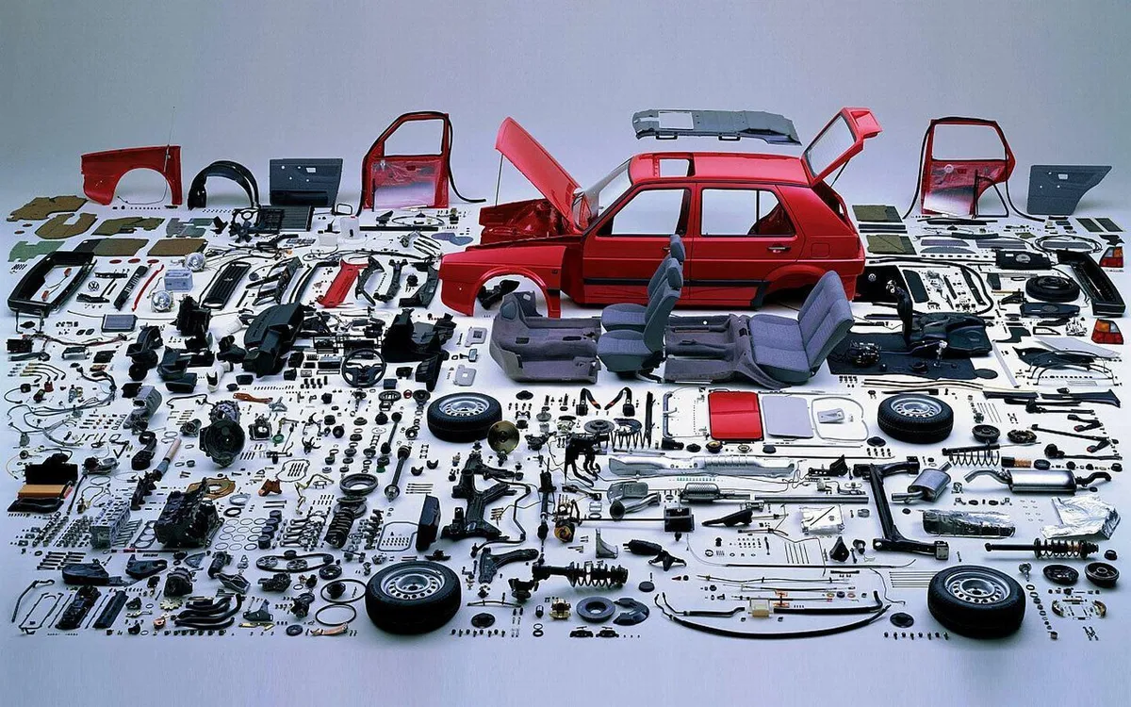

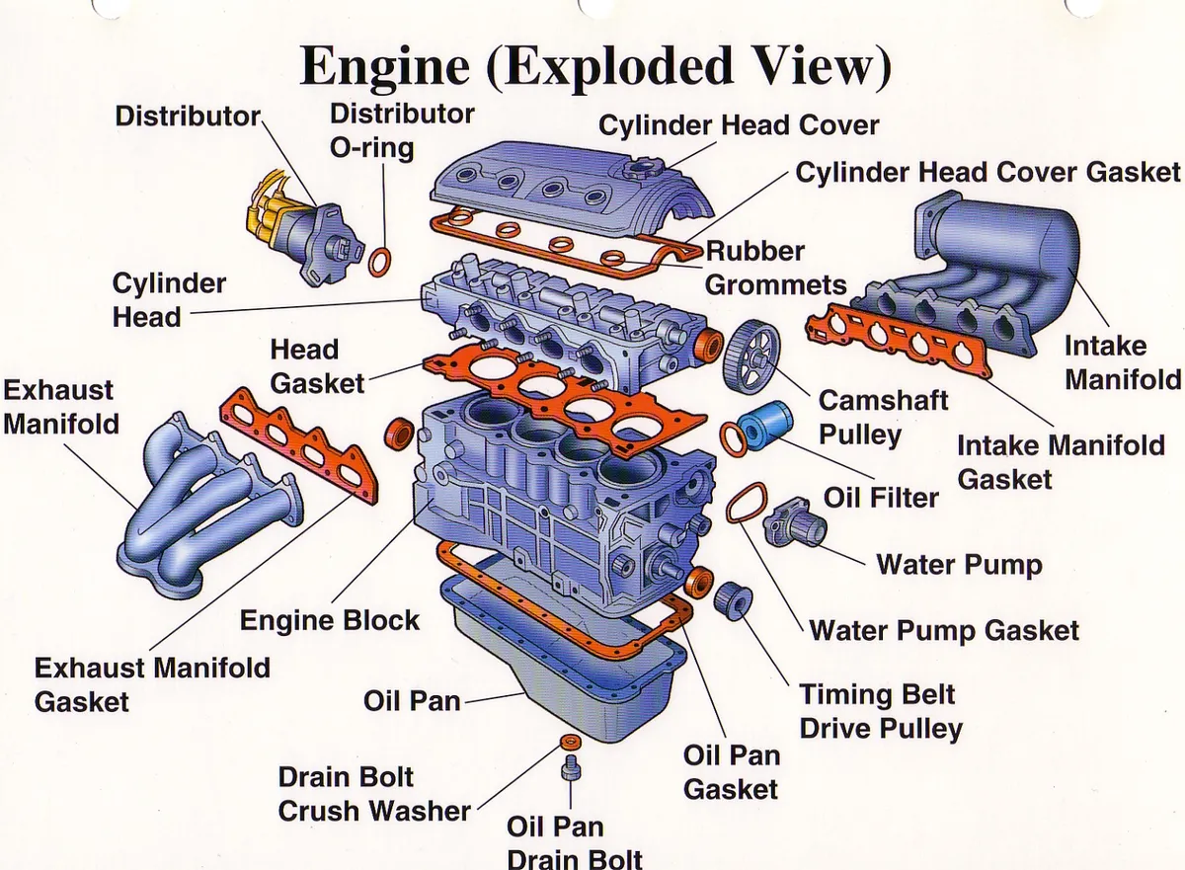
How is the economic activity taking place?

Slide 6
What is the best way to organize economic activities?
The definition of “best” might depend on each individual’s preferences, so it’s controversial to find an aggregate optimum.
  Example: how would you organize the calendar of case presentations? Alternatives, preferences, restrictions.
One popular criterion widely accepted among economists is the Pareto efficiency: “there exists no alternative production/distribution of goods that keeps all individuals at least as well off but makes even one person better off”
  If an economic system is not producing or distributing goods efficiently, it is conceptually possible to make its members better off by adopting Pareto-improving change

Slide 7
What is the best way to organize economic activities?
Pareto-Efficiency and Inequality
  Suppose you and your friend find $100 on the street
  How can you distribute/allocate this resource?
  Are all of them Pareto-efficient? Limitation: which is the best one?
  Are all of them fair? The role of inequality
Let go back to a production/distribution economy: What should be the goal of the economic system?
Suggested reading

Slide 8
A market economy requires property rights
A property right is a legally enforced right to select the uses of an economic good
A property right is private when it is assigned to a specific person. Private property rights can be transferred (sold or given) to another individual
  For example, if Valeria Fontana owns an automobile, she can use the automobile as she sees fit (within limits set by traffic laws). Valerie can restrict others from using her vehicle.
In a market economy, private property right owners have the legal rights to decide how to use their resources. They can decide to use the resources or selling their property rights to other individuals
  This is not the case in a centrally planned economy, where properties are owned by the state and government officials decide their use.

Slide 9
A market economy requires property rights
A property right has two (independent) legal dimensions:
  Right to use
  Alienability right (right to sell or transfer)
Consider the following hypothetical legal contract from a private property right perspective.
  1) contract to sell your car
  2) contract to sell one of your kidneys
  3) contract to lease/rent your car

Slide 10
Gains from Trade
So people order the alternative uses of its properties in terms of their preferences.
They pick the actions that maximize their level of satisfaction/utility
Why do they trade?
  Because buyers place a higher value on those items/services than the sellers
  The corresponding gains from trade make both parties better off: Pareto efficient!
This is important because it means that voluntary trade is mutually advantageous
Where do these gains from trade come from?
  Different preferences
  Comparative advantage: seller can produce the item more cheaply than the buyer

Slide 11
Comparative Advantage
Individuals having property rights on goods have to decide what to do with them:
  Consumption
  Saving them for the future
  Use them for producing other goods (this course!)
What should they produce? The role of comparative advantage

Slide 12
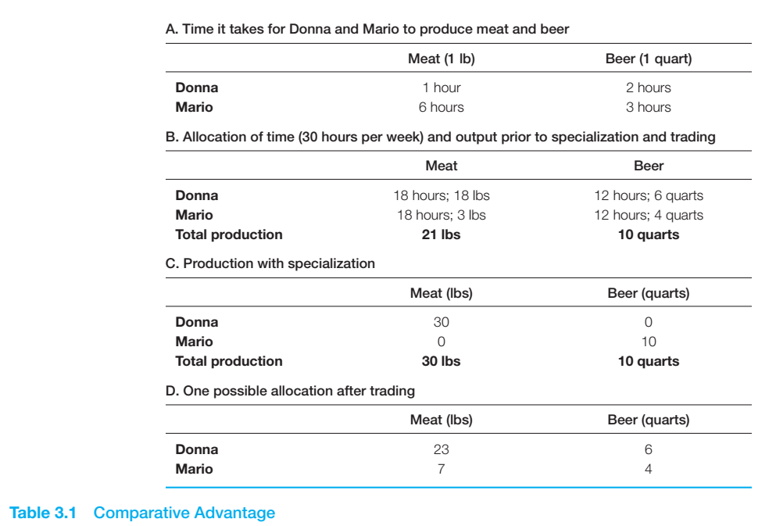
Comparative Advantage
Example (from the “Brickley et al.,”)
Absolute advantage vs Comparative advantage
Mario has a comparative advantage (lower opportunity cost) for producing beer:
  1q of beer=1/2p of meat (Donna’s=2p of meat)
Donna has a comparative advantage in hunting
  1p of meat= 1/2q of beer (Mario’s=2q of beer)
After specialization comes bargaining (panel D)

Slide 13
Comparative Advantage
Specialization and trading are common features in “market economies” around the world
Important for us, it also arises in managerial situations
  CEOs create gains from “delegating” to specialized Managers: Marketing, Sales, auditors, IT, Operations, etc.

Slide 14
Basics of Supply and Demand in a market economy
So individuals trade for capturing gains from free market transactions
But markets consists of thousands (if not millions of people)
  Why we don’t see (frequently) huge shortage or surpluses of goods
  How do they coordinate? The market-price system

Slide 15
Basics of Supply and Demand in a market economy
The market-price system
The market includes all potential buyers and sellers of the item
  So many buyers and sellers than individual transactions are not relevant for the overall market
  The price is not affected by any single sale
No economic agent has economic power
All trades are made at the market price
This is what economists define as “competitive markets”

Slide 16
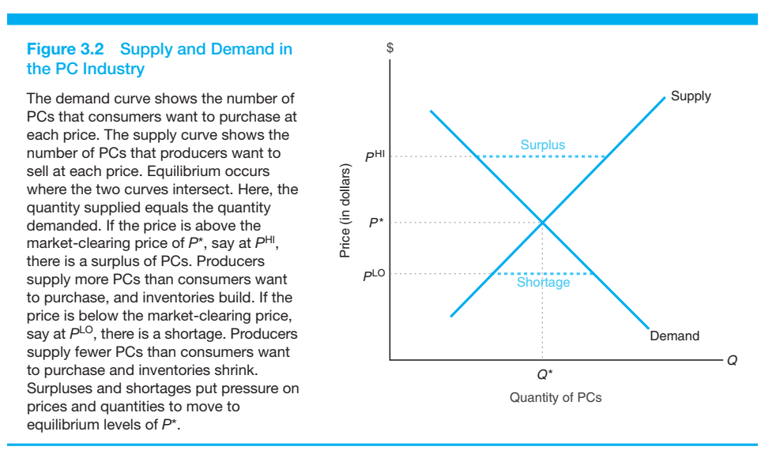
Basics of Supply and Demand in a market economy
Key concepts:
Market-clearing (or equilibrium) price
Market pressures in shortage or surpluses scenarios
Static equilibrium… but what happened if supply or demand curve shifts?

Slide 17
Basics of Supply and Demand in a market economy
It is important to distinguish between shifts in demand/supply curves (change in demand or supply) and changes along the given curves (changes in the quantity demanded/supplied)
  Curve shifts: changes in non-price variables leads to increases/decreases in supply/demand (at any given price)
  Movements along the curve: driven by a change in price (holding other variables constant). It changes the quantity demanded/supplied

Slide 18
Prices as a social coordinator
The equilibrium of supply and demands highlights the informative role of market price to coordinate production and consumption decisions of individuals
If everyone trades in a competitive marketplace and all mutually advantageous trades are completed, the price system results in a Pareto-Efficient resource allocation.
  Consumers and producers, acting in their own self-interest, react to price signals in a manner that produces an efficient resource allocation
  Firms have strong private incentives to pursue the most efficient production methods and the value-maximizing output mix
  No changes in consumption nor production can be made without making someone worse off

Slide 19
Government intervention: price control
Price Cap: given that the regulated price is lower than the market price, the intervention produces an excess demand and production shortage. This situation implies that the regulated good must be allocated through non-price mechanisms.
  Goods may be allocated via arbitrary methods like queuing (waiting in line), lotteries, favoritism or even violence
  It also distorts other related markets, and create incentives for black markets.
  Example: gasoline price cap and its effect in gasoline and transportation markets

Slide 20
Government intervention: price control
Price Floor: given that the regulated price is higher than the market price, the intervention produces a shortage in demand and supply excess.
  Example: labor market and minimum wage.
In general, economic evidence is consistent with price control results in shortages, lack of investments, quality degradation, and an overall reduction in consumer welfare
Notice that other economic regulations that we will discuss today have positive welfare effects. So it is not about not economic regulations, but about good ones.

Slide 21
Why do firms exist?
If markets economies produce Pareto-efficient solutions, why do we need firms that behave so closely as central planners?
  All production and exchange can be carried out via market transactions

Slide 22
Why do firms exist?
In reality, firms carried out a large fraction of economic transactions within their border.
  Example: transferring a manager from one division to another.
    There is no market price for the manager.
    Divisions do not bid to hire the manager.

Slide 23
Why do firms exist?
Firms exist because market transactions involve contracting costs such as:
  Search cost
  Information cost
  Bargaining/decision cost
  Policing/monitoring/enforcement cost
In many cases, the economic organization that minimizes these contracting costs is the firm.
Reducing these costs makes transaction cheaper and safer!
- Here there is a lot of room for good economic policies: product labeling, consumer/lender protection, commercial law, and so on.

Slide 24
Why do firms exist?
An example of the benefit of arranging economic activity through firms
  Suppose 10 highly specialized workers are needed to ensemble a supercomputer and there are 1000 customers.
  In a fully free-market economy, there must be 10x1000=10.000 negotiations to reach an efficient allocation of the supercomputers
  However, a firm must negotiate 10 times (contracting workers)+1.000 times (dealing with costumers)=1.010.
  Besides, the firms can specialize in the type of knowledge needed, thus, getting an informational competitive advantage. Costumers do not need to know the specs of each computer component.

Slide 25
Why do firms exist?
However, there are limits for the firms’ advantage in contracting costs:
  Larger firms are difficult to manage efficiently
  Large firms do not respond fast to changes in the environment
  In large firms, some value-relevant decisions are delegated to employees who do not bear the consequences of their decisions

Slide 26
Summary
Main concepts
Free-market economy
Central planner
Pareto efficiency
Property rights
Comparative advantage
Price control
Contracting costs

Slide 27
Cases to discuss
Present an real case related to some of the topics of the class.
  The case should be based on recent news (<2 years) and preferably related to Spanish companies/cases.
  Start the presentation with the theory section, then the case, and finally apply the theory to conclude/assess the case.
  10 min, 7-11 slides
  Examples:
    1) property rights and the “Okupas” problem.
    2) Spain or EU regulation that reduce or increase transaction costs.

